Slide 1
PH 0101 UNIT-3 LECT - 7
TYPES OF OPTICAL FIBRE,
OPTICAL FIBRE BASED ON MODES (OR) MODE TYPES
UNIT III Lecture 7

Slide 2
Types of optical fibers
Optical fibers are classified based on
        Material
Number of modes and
Refractive index profile
UNIT III Lecture 7

Slide 3
Optical fibers based on material :
Optical fibers are made up of materials like silica and plastic. The basic optical fiber material must have the following properties:
(i) Efficient guide for the light waves
(ii) Low scattering losses
(iii) The absorption, attenuation and dispersion of optical energy must be low.
Based on the material used for fabrication, they are classified into two types:
Glass fibers and
Plastic fibers
UNIT III Lecture 7

Slide 4
Glass fibers : Silica fibers
The glass fibers are generally fabricated by fusing mixtures of metal oxides and silica glasses.
Silica has a refractive index of 1.458 at 850 nm. To produce two similar materials having slightly different indices of refraction for the core and cladding,various oxides such as B₂O₃, GeO₂ or P₂O₃ are added to silica.
Examples:
      SiO₂ core; P₂­O₃ – SiO₂ cladding
      GeO₂ – SiO₂ core; SiO₂ cladding
      P₂O₅ – SiO₂ core; SiO₂ cladding
UNIT III Lecture 7

Slide 5
Halide glass fibers
Flouride glasses have low attenaution in .2-8um wavelength band.
From general family of halide glasses , elements like chlorine,flourine,iodine and bromine.
ZBLAN core- ZrF4,BaF2,LaF3,AlF3,NaF
Cladding- by partially combining with HaF4.
Ultrapure materials needed
UNIT III Lecture 7

Slide 6
Divitrification -Devitrification occurs in glass art during the firing process of fused glass whereby the surface of the glass develops a whitish scum, crazing, or wrinkles instead of a smooth glossy shine, as the molecules in the glass change their structure into that of crystalline solids.
UNIT III Lecture 7

Slide 7
Active Glass fibers
Incorporating rare earth elements (57-71) into normal silica glass fibers give active glass fibers.
This will improve amplification properties of fiber.
Eg: EDFA- Erbium doped fiber amplifier
UNIT III Lecture 7

Slide 8
Chalgenide Glass Fibers
Exploring non linear properties of fiber like kerr effect.
Applications like optical switches.
One chalogen element like S,Se,Te
with elements like P,Cl…etc
As2O3-well known material
Singlemode fiber
loss 1dB/Km
UNIT III Lecture 7

Slide 9
Plastic-Clad glass fibers
-For short distance application, If high losses are tolerable.
Silica core and low refractive index cladding which is a polymer.
Known as PCS- Plastic clad silica fiber.
Common source material for silica core is high purity natural quarts.
Common source material for cladding is silicone resin which is having RI =1.405 at 850 nm
Another material for cladding is perflouronated ethylene propelene – RI=1.338-High numerical aperture.
Used for step index fibers
UNIT III Lecture 7

Slide 10
Plastic fibers :
The plastic fibers are typically made of plastics and are of low cost.
Although they exhibit considerably greater signal attenuation than glass fibers, the plastic fibers can be handled without special care due to its toughness and durability.
Due to its high refractive index differences between the core and cladding materials, plastic fibers yield high numerical aperture and large angle of acceptance.
UNIT III Lecture 7

Slide 11
The core of the plastic fibers are either polymethyl methacrylate (PMMA) or perfluorinated polymer (PF).
Accordingly those optical fibers are referred as PMMA POF and PF POF.
With plastic fibers NA of .6 and acceptance angle of 70 degrees also posiible.
Core diameter of 110um-1400um is possible.
UNIT III Lecture 7

Slide 12
Examples:
A polymethyl methacrylate core (n₁ = 1.59) and a cladding made of its co-polymer
(n₂ = 1.40).
A polysterene core (n₁ = 1.60) and a methylmetha crylate cladding (n₁ = 1.49).
UNIT III Lecture 7

Slide 13
Photonic Crystal Fibers
Otherwise known as holey fiber or micro structured fiber.
They contain air holes in cladding and in some cases in core regions which run along the entire length of the fiber.
This structural arrangement in a PCF creates an internal microstructure which offers another dimension of light control in fiber.
2 Types. A) Index guiding PCF B) Photonic Band gap fiber
UNIT III Lecture 7

Slide 14
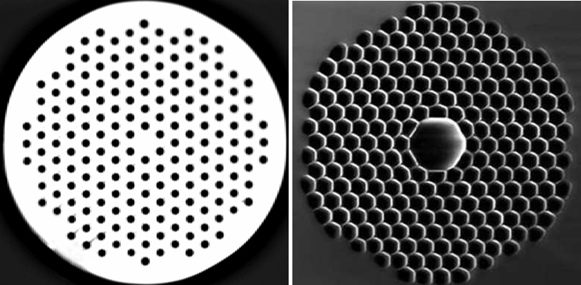
solid core
Hollow core
A. Index guiding PCF B.Photonic Band gap fiber
UNIT III Lecture 7

Slide 15
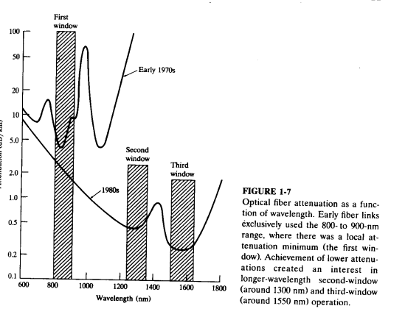
LOSS & BANDWIDTH WINDOW
UNIT III Lecture 7

Slide 16
Optical fibers based on modes or mode types :
Mode is the one which describes the nature of propagation of electromagnetic waves in a wave guide.
i.e. it is the allowed direction whose associated angles satisfy the conditions for total internal reflection and constructive interference.
Based on the number of modes that propagates through the optical fiber, they are classified as:
Single mode fibers
Multi mode fibers
UNIT III Lecture 7

Slide 17
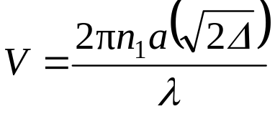
Single mode fibers:
In a fiber, if only one mode is transmitted through it, then it is said to be a single mode fiber.
A typical single mode fiber may have a core radius of 3 μm and a numerical aperture of 0.1 at a wavelength of 0.8 μm.
The condition for the single mode operation is given by the V number of the fiber which is defined as such that V ≤ 2.405.
Here, n₁ = refractive index of the core; a = radius of the core; λ = wavelength of the light propagating through the fiber; Δ = relative refractive indices difference.
UNIT III Lecture 7

Slide 18
The single mode fiber has the following characteristics:
Only one path is available.
V-number is less than 2.405
Core diameter is small
No dispersion
Higher band width (1000 MHz)
Used for long haul communication
Fabrication is difficult and costly
UNIT III Lecture 7

Slide 19
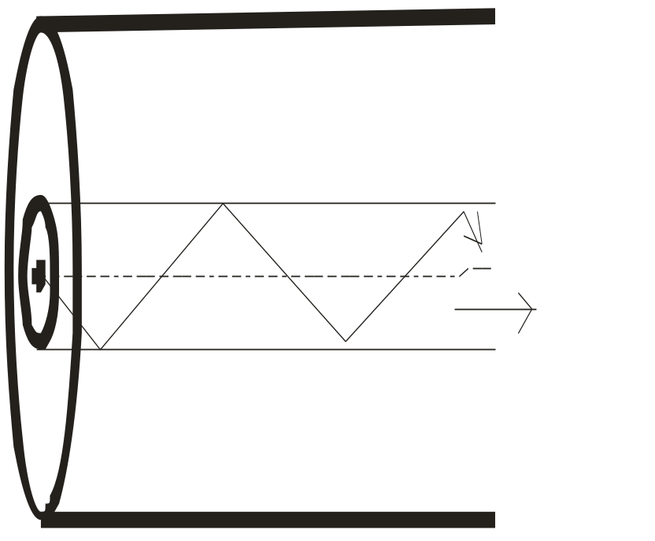
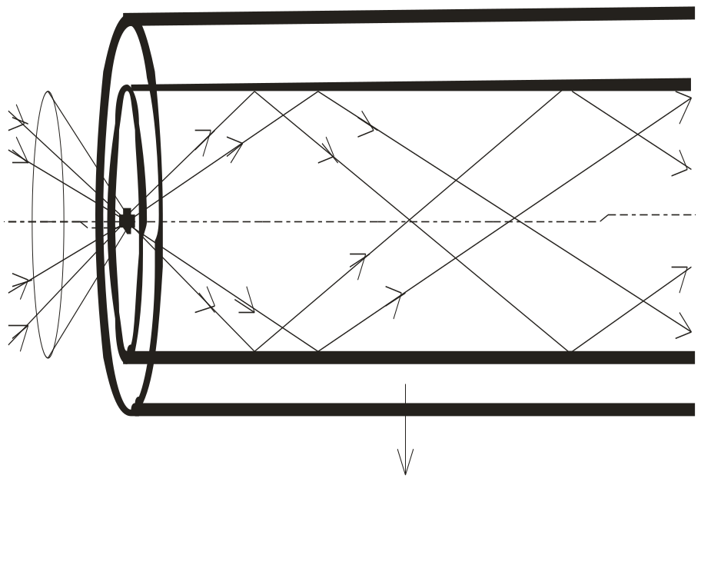
SINGLE MODE FIBER
MULTI MODE FIBER
UNIT III Lecture 7

Slide 20
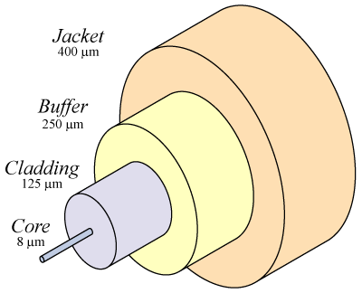

UNIT III Lecture 7

Slide 21
Multi mode fibers :
If more than one mode is transmitted through optical fiber, then it is said to be a multimode fiber.
The larger core radii of multimode fibers make it easier to launch optical power into the fiber and facilitate the end to end connection of similar powers.
Some of the basic properties of multimode optical fibers are listed below :
More than one path is available
V-number is greater than 2.405
UNIT III Lecture 7

Slide 22
Countd.
Core diameter is higher
Higher dispersion
Lower bandwidth (50MHz)
Used for short distance communication
Fabrication is less difficult and not costly
Optical fibers based on refractive index profile :
Based on the refractive index profile of the core and cladding, the optical fibers are classified into two types:
  Step index fiber
  Graded index fiber.
UNIT III Lecture 7

Slide 23
Step index fiber :
In a step index fiber, the refractive index changes in a step fashion, from the centre of the fiber, the core, to the outer shell, the cladding.
It is high in the core and lower in the cladding. The light in the fiber propagates by bouncing back and forth from core-cladding interface.
The step index fibers propagate both single and multimode signals within the fiber core.
The light rays propagating through it are in the form of meridinal rays which will cross the fiber core axis during every reflection at the core – cladding boundary and are propagating in a zig – zag manner.
UNIT III Lecture 7

Slide 24
The refractive index (n) profile with reference to the radial distance (r) from the fiber axis is given as:
when r = 0, n(r) = n1
r < a, n(r) = n1
r ≥ a, n(r) = n2
UNIT III Lecture 7

Slide 25
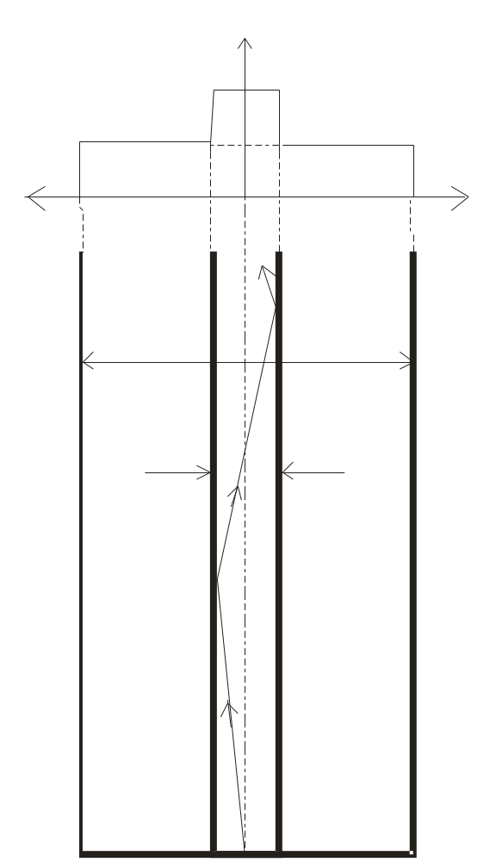
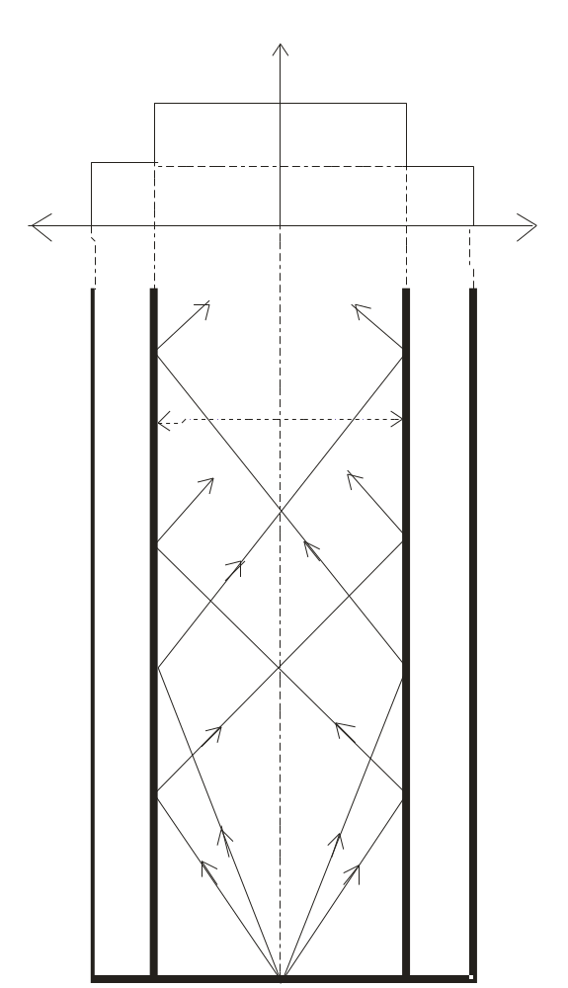
STEP INDEX FIBER
UNIT III Lecture 7

Slide 26
Step index single mode fibers :
The light energy in a single-mode fiber is concentrated in one mode only.
This is accomplished by reducing Δ and or the core diameter to a point where the V is less than 2.4.
In other words, the fiber is designed to have a V number between 0 and 2.4.
This relatively small value means that the fiber radius and Δ, the relative refractive index difference, must be small.
No intermodal dispersion exists in single mode fibers because only one mode exists.
UNIT III Lecture 7

Slide 27
Contd.
With careful choice of material, dimensions and λ, the total dispersion can be made extremely small, less than 0.1 ps /(km × nm), making this fiber suitable for use with high data rates.
In a single-mode fiber, a part of the light propagates in the cladding.
The cladding is thick and has low loss.
Typically, for a core diameter of 10 μm, the cladding diameter is about 120 μm.
Handling and manufacturing of single mode step index fiber is more difficult.
UNIT III Lecture 7

Slide 28
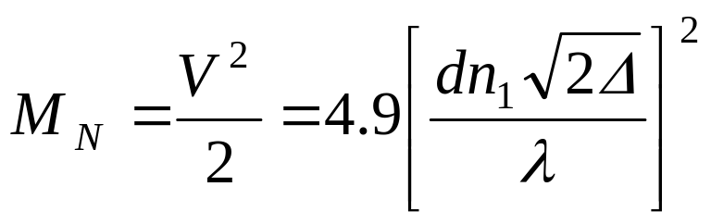
Step index multimode fibers :
A multimode step index fiber is shown.
In such fibers light propagates in many modes.
The total number of modes MN increases with increase in the numerical aperture.
For a larger number of modes, MN can be approximated by
UNIT III Lecture 7

Slide 29
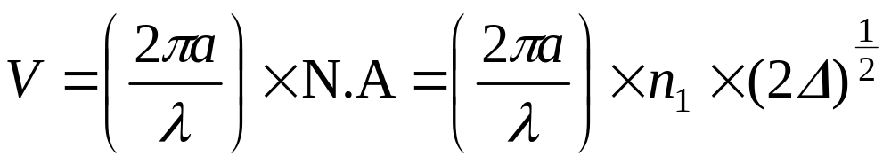
Contd.
where d = diameter of the core of the fiber and V = V – number or normalized frequency.
The normalized frequency V is a relation among the fiber size, the refractive indices and the wavelength. V is the normalized frequency or simply the V number and is given by
where a is the fiber core radius, λ is the operating wavelength, n1 the core refractive index and Δ the relative refractive index difference.
UNIT III Lecture 7

Slide 30
.
The core diameter of the typical multimode fiber varies between 50 μm and about 200 μm, with cladding thickness typically equal to the core radius.
UNIT III Lecture 7

Slide 31
Graded index fibers :
A graded index fiber is shown in Fig.3.27. Here, the refractive index n in the core varies as we move away from the centre.
The refractive index of the core is made to vary in the form of parabolic manner such that the maximum refractive index is present at the centre of the core.
The refractive index (n) profile with reference to the radial distance (r) from the fiber axis is given as:
UNIT III Lecture 7

Slide 32
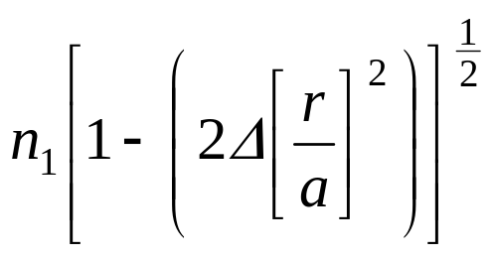
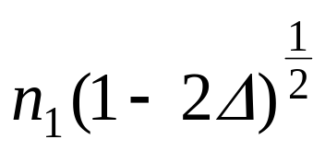
when r = 0, n(r) = n1
r < a, n(r) =
r ≥ a, n(r) = n2 =
At the fiber centre we have n1; at the cladding we have n2; and in between we have n(r), where n is the function of the particular radius as shown in Fig. simulates the change in n in a stepwise manner.
UNIT III Lecture 7

Slide 33
Contd.
Each dashed circle represents a different refractive index, decreasing as we move away from the fiber center.
A ray incident on these boundaries between n_{a} – n_{b}, n_{b} – n_{c} etc., is refracted.
Eventually at n₂ the ray is turned around and totally reflected.
This continuous refraction yields the ray tracings as shown in Fig.
UNIT III Lecture 7

Slide 34
Contd.
The light rays will be propagated in the form skew rays (or) helical rays which will not cross the fiber axis at any time and are propagating around the fiber axis in a helical or spiral manner.
The effective acceptance angle of the graded-index fiber is somewhat less than that of an equivalent step-index fiber. This makes coupling fiber to the light source more difficult.
UNIT III Lecture 7

Slide 35
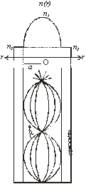
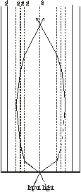
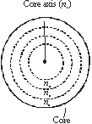
(b)
GRADED INDEX FIBER
Fig. 2.7 (A) INDEX PROFILE
(B) STEPWISE INDEX PROFILE
(C) RAY TRACING IN STEPWISE INDEX PROFILE
(a)
UNIT III Lecture 7
(c)

Slide 36
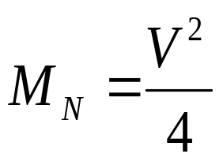
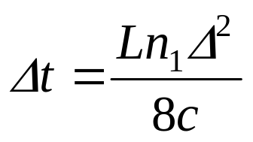
The number of modes in a graded-index fiber is about half that in a similar step-index fiber,
The lower the number of modes in the graded-index fiber results in lower dispersion than is found in the step-index fiber. For the graded-index fiber the dispersion is approximately (Here L = Length of the fiber; c = velocity of light).
(Here L = Length of the fiber; c = velocity of light).
UNIT III Lecture 7

Slide 37
Countd.
The size of the graded-index fiber is about the same as the step-index fiber. The manufacture of graded-index fiber is more complex. It is more difficult to control the refractive index well enough to produce accurately the variations needed for the desired index profile.
UNIT III Lecture 7

Slide 38
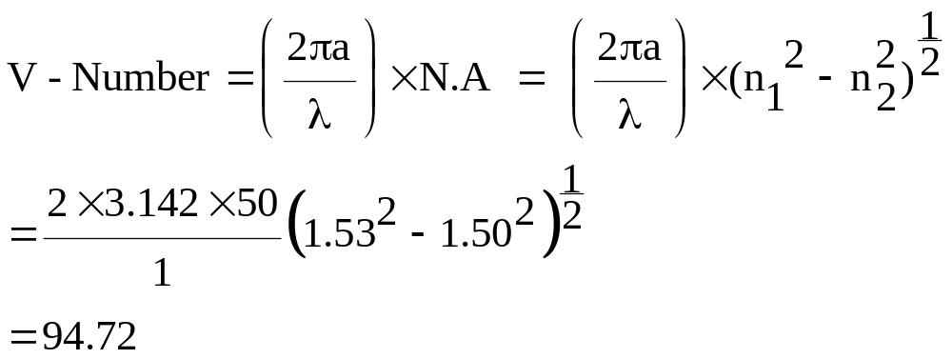
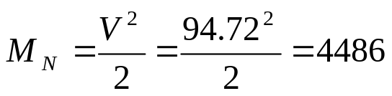
Solved Problem (1) : Calculate the V – number and number of modes propagating through the fiber having a = 50 μm, n1 = 1. 53, n2 = 1.50 and λ = 1μm.
n1 = 1.53 ; n2 = 1.50; λ = 1μm.
The number of modes propagating through the fiber
V – number = 94.72 ; No. of modes = 4486
UNIT III Lecture 7

Slide 39
Exercise (1) : Find the core radius necessary for single mode operation at 850 nmof step index fiber with n₁ = 1.480 and n₂ = 1.465.
Hint: V – number = 2.405 ( for single mode fiber)
a = core radius = 1.554 μm
UNIT III Lecture 7

